Slide 1
- History of human impact and emissions
- History of climate science and scientific diagnostics
- History of political context
.
Climate and human activities:
Interaction between various histories

Slide 2
- 1967: The Global Atmospheric Research Project
- 1980: The World Climate Research Programme (WMO, ICSU, UNESCO)
(1st Director: Pierre Morel, UPMC)
- Atmospheric Intercomparison Programme (AMIP, PCMDI, Larry Gates)
- Coupled Model Intercomparison Programme (WGCM)
- 1988: The Intergovermental Panel on Climate Change
The alert: key dates (1)

Slide 3
- 1896: Svante Arrhenius
- 1955: R. Revelle and H. Suess,"Carbon Dioxide Exchange Between Atmosphere and Ocean and the Question of an Increase of Atmospheric CO₂ During the Past Decades." Tellus 9 (1957): 18-27.
- 1957: Mauna Loa Observatory (Charles Keeling, International Polar Year)
- 1979: Jules Charney, Report to the National Academy of Sciences
- 1990: First Assessment Report of the IPCC
- 1992: United Nation Framework Convention on Climate Change (UNFCCC)
The alert: key dates (2)

Slide 4
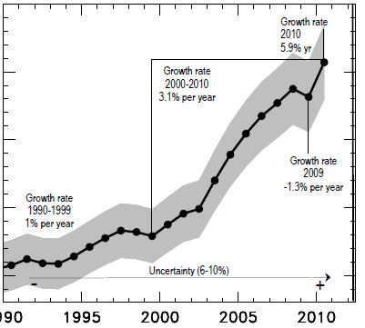
CO₂ emissions from the use of fossil fuels: still increasing (International
Energy Agency).
Eath Summit 1992
International Energy Agency

Slide 5
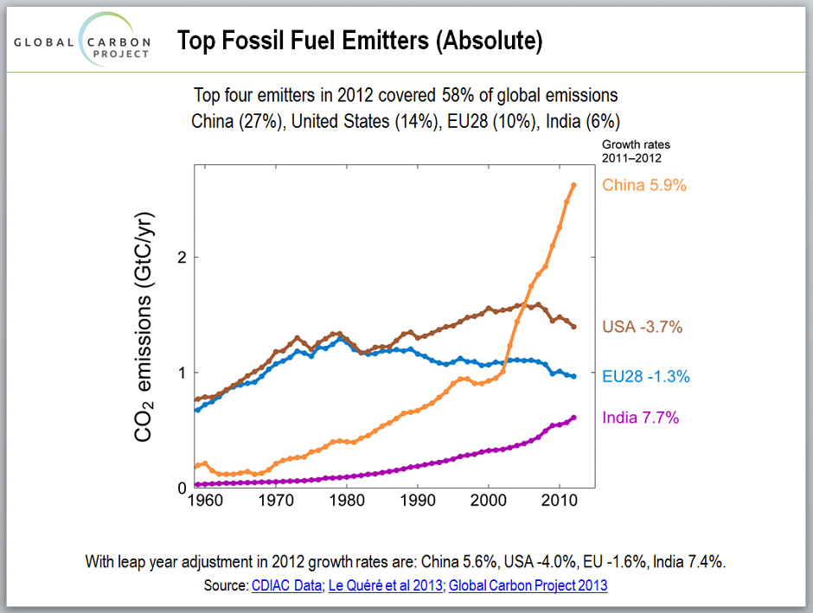

Slide 6
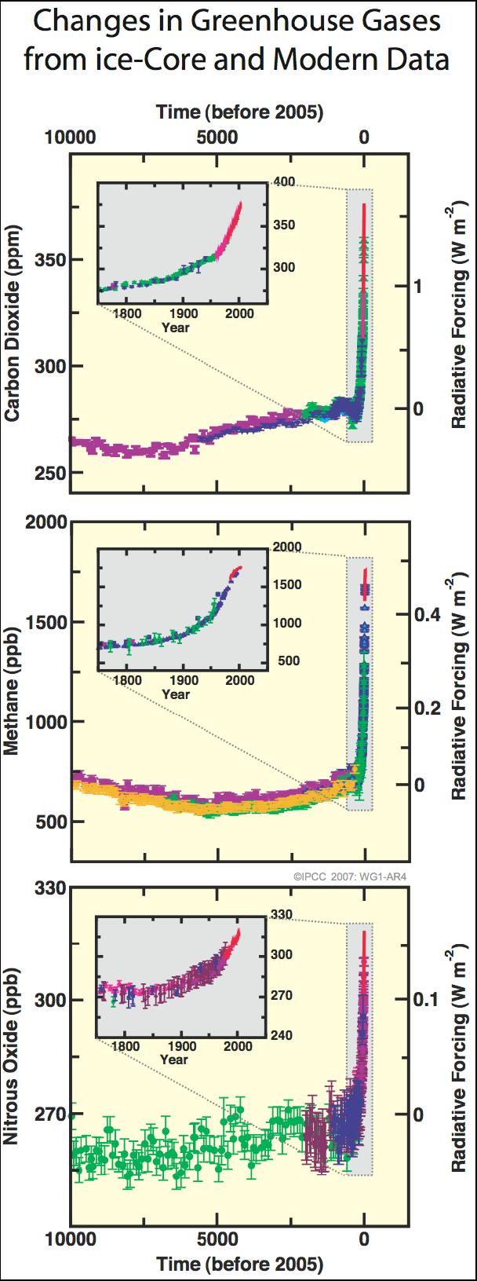

Slide 7
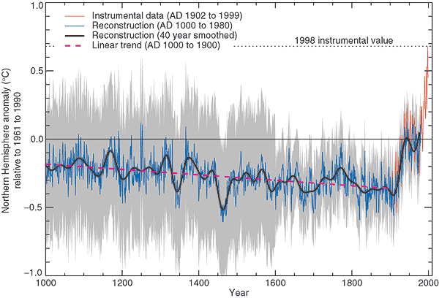
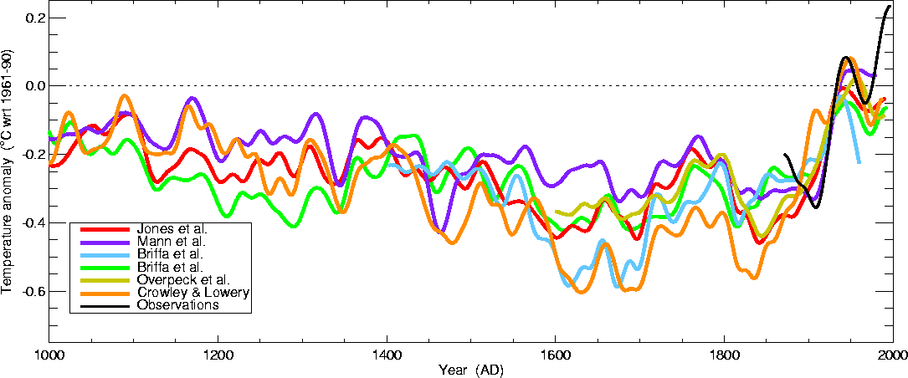
Des effets déjà sensibles?
Mann, IPCC, 2001

Slide 8
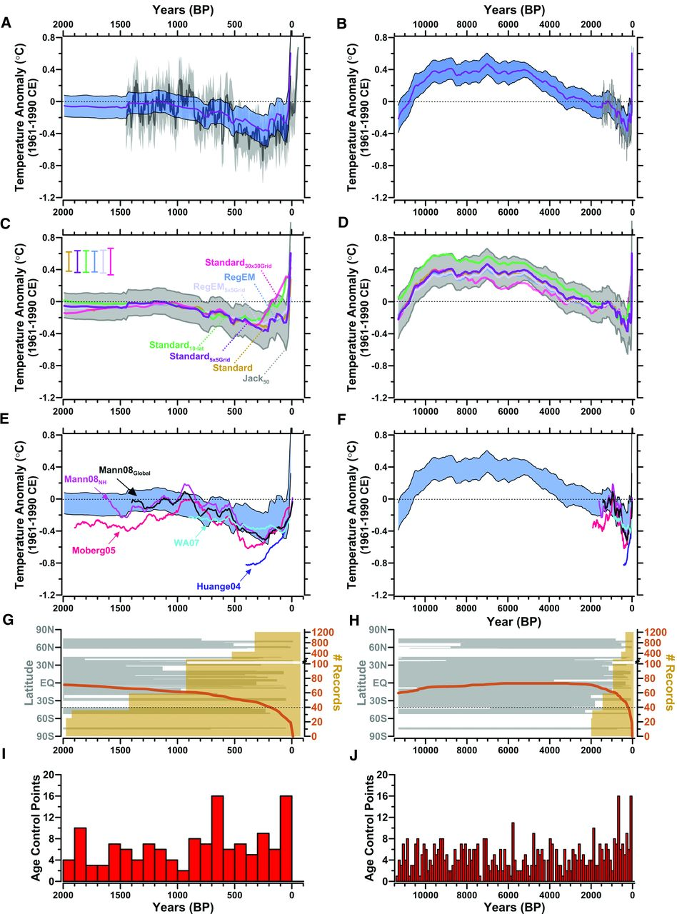

Fig. 1 Comparison of different methods and reconstructions of global and hemispheric temperature anomalies.
Shaun A. Marcott et al. Science 2013;339:1198-1201
Published by AAAS
Notes:
Comparison of different methods and reconstructions of global and hemispheric temperature anomalies. (A and B) Globally stacked temperature anomalies for the 5° × 5° area-weighted mean calculation (purple line) with its 1σ uncertainty (blue band) and Mann et al.'s global CRU-EIV composite mean temperature (dark gray line) with their uncertainty (light gray band). (C and D) Global temperature anomalies stacked using several methods (Standard and Standard_{5x5Grid; 30x30Grid; 10-lat}: Arithmetic mean calculation, area-weighted with a 5° × 5° grid, area-weighted with a 30° × 30° grid, and area-weighted using 10° latitude bins, respectively; RegEM and RegEM_{5x5Grid}: Regularized expectation maximization algorithm-infilled arithmetic mean and 5° × 5° area-weighted). The gray shading [50% Jackknife (Jack₅₀)] represents the 1σ envelope when randomly leaving 50% of the records out during each Monte Carlo mean calculation. Uncertainties shown are 1σ for each of the methods. (E and F) Published temperature anomaly reconstructions that have been smoothed with a 100-year centered running mean, Mann08_{Global} (2), Mann08_{NH} (2), Moberg05 (3), WA07 (8), Huange04 (36), and plotted with our global temperature stacks [blue band as in (A)]. The temperature anomalies for all the records are referenced to the 1961–1990 instrumental mean. (G and H) Number of records used to construct the Holocene global temperature stack through time (orange line) and Mann et al.'s (2) reconstruction (gold vertical bars). Note the y axis break at 100. The latitudinal distribution of Holocene records (gray horizontal bars) through time is shown. (I and J) Number of age control points (e.g., ¹⁴C dates) that constrain the time series through time.

Slide 9
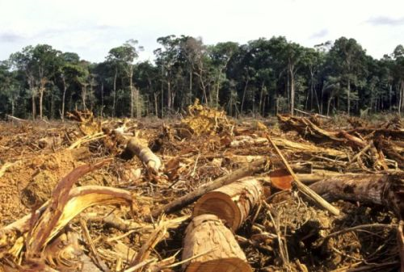

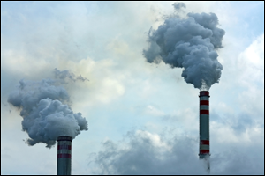

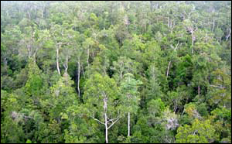
The Human Perturbation of the CO₂ Budget (2000-2009)
7.7±0.5 PgC y⁻¹
4.1±0.1 PgC y⁻¹
47%
+
2.4 PgC y⁻¹
27%
1.1±0.7 PgC y⁻¹
Calculated as the residual
26%
2.3±0.4 PgC y⁻¹
9
Global Carbon Project 2010; http://www.globalcarbonproject.org/carbonbudget/index.htm
Notes:
9

Slide 10
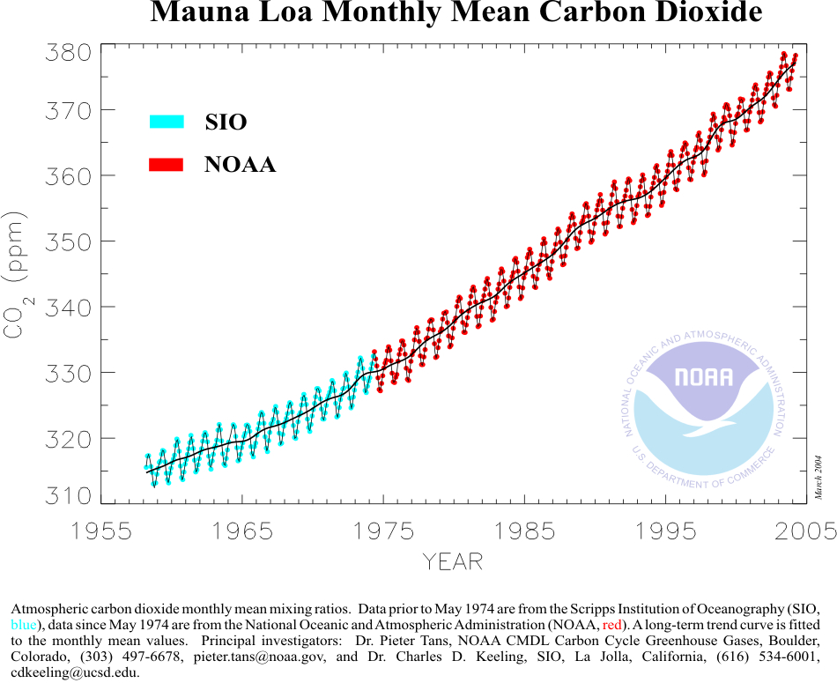
During the anthropocene, the carbon cycle is driven by fossil fuel emissions, and limited by sinks
The Earth
without carbon cycle
Land and ocean sinks
A 50 Billion € y⁻¹
discount on climate change
10
Notes:
10

Slide 11
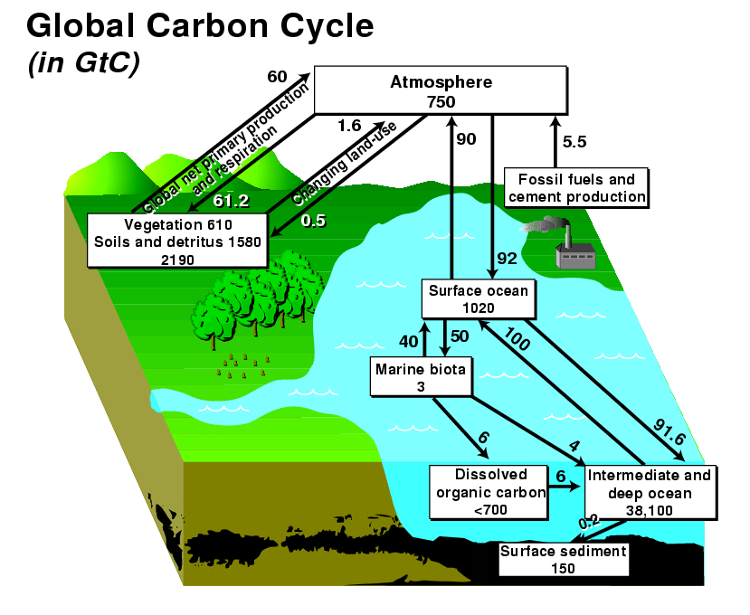
Equilibium/ Deequilibrim of a complex system: the carbon cycle
GIEC, 1990 - CDIAC

Slide 12
IPCC 2013, Group 1, Chapter 6

Slide 13
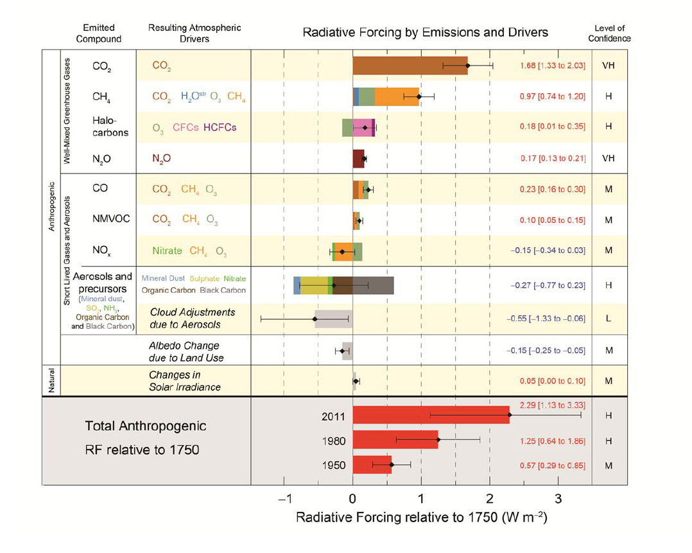
Greenhouse gases radiative forcing: a more recent – but more
complex assessment (IPCC, 2013)

Slide 14
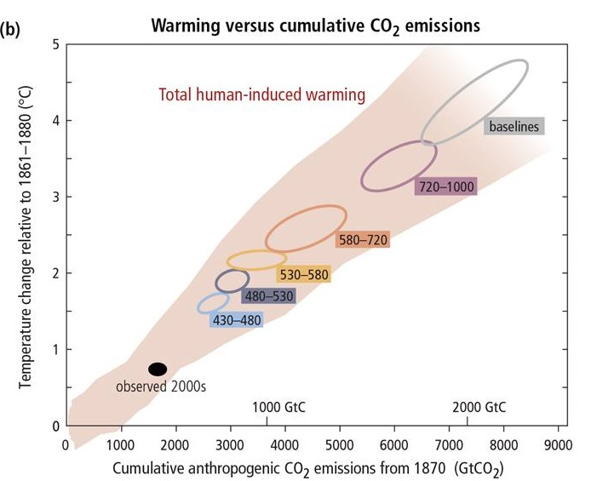
A constraint on possible scenarios: the link between CO₂ cumulated emissions and the 2°C target
Source : IPCC, AR5, WG1, 2014

Slide 15
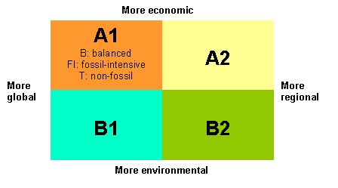
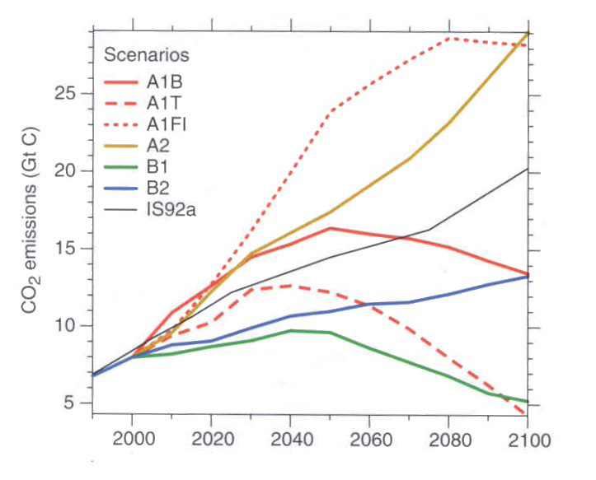
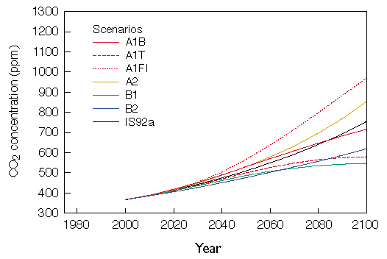
The IPCC « SRES » scenarios (1999)

Slide 16
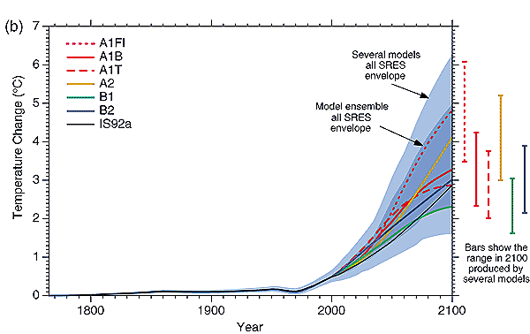
The SRES projections (IPCC, 2001)

Slide 17
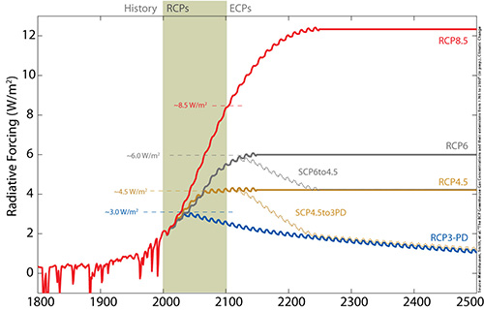
A new approach of Cllimate Scenarios: The RCP

Slide 18
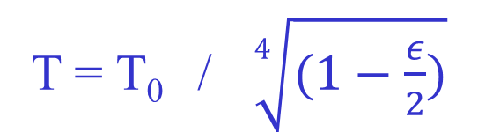
What do we call Radiative forcing?
Rs (1-α)
(1−ε)σT⁴
Ra
Top of the atmosphere
εσT⁴
Absorption and raddaitio
Terrestre
Rs (1-α) - As
Ra
Soil
σT⁴
Soil temperature when neglecting A_{s} (absorption of solar radiiation) as a function of température T₀ sans effet de serre

Slide 19
Sensitivity to Radiative Forcing
z
stratosphere
Higher
Equivalent
Emission
Level
troposphere
z*
T*
T
Warming

Slide 20
Atmospheric thermal
response to:
(1) Solar radiation increase
(2)Greenhouse gases increase
(3) Aerosol increase
Cannot be explained without
feedbacks
Latitude / altitude diagram

Slide 21
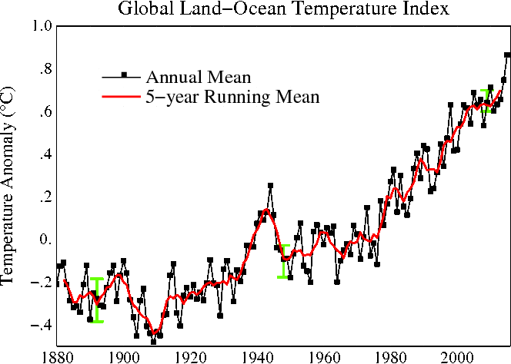

Slide 22
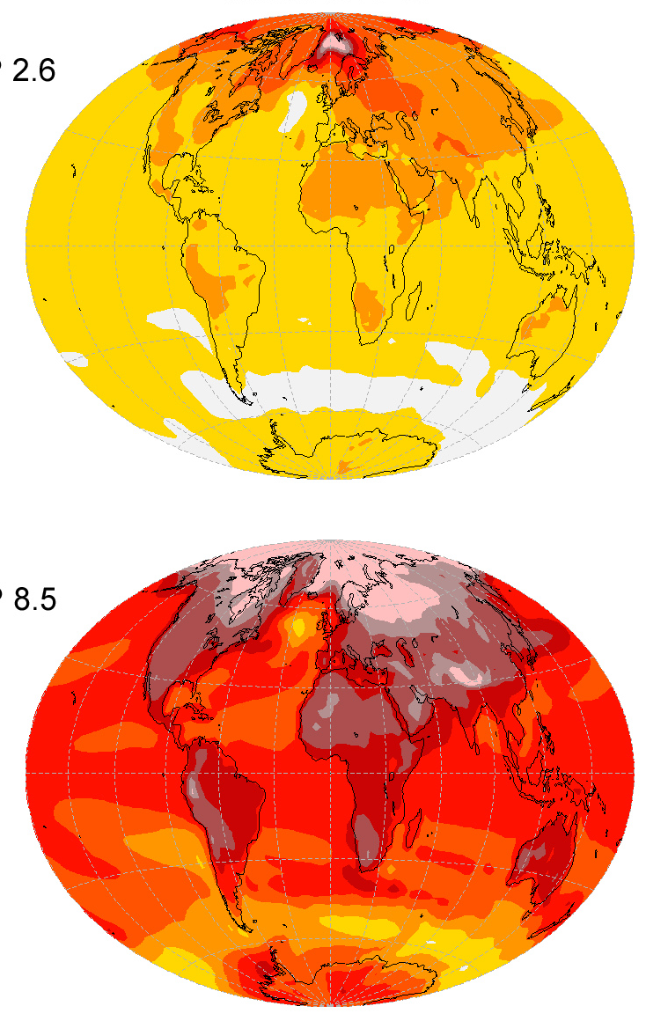
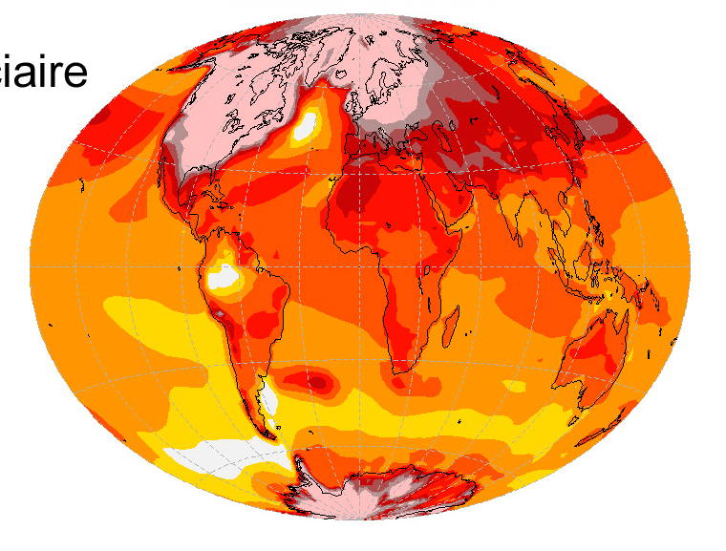
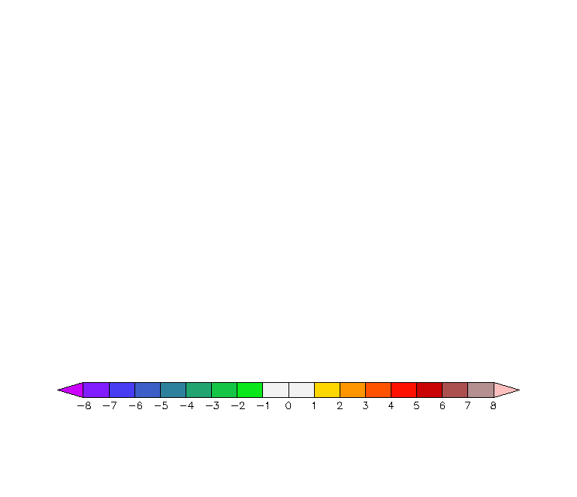
What do models tell about climate change?
IPSL-CM5A-LR
From 1990 to 2100
From glacial to preindustrial eras
With strong
efforts
Business as
usual
(°C)
-8
-6
-4
-2
0
2
4
6
8
Notes:
22
Anomalies par rapport à 1961-1990

Slide 23
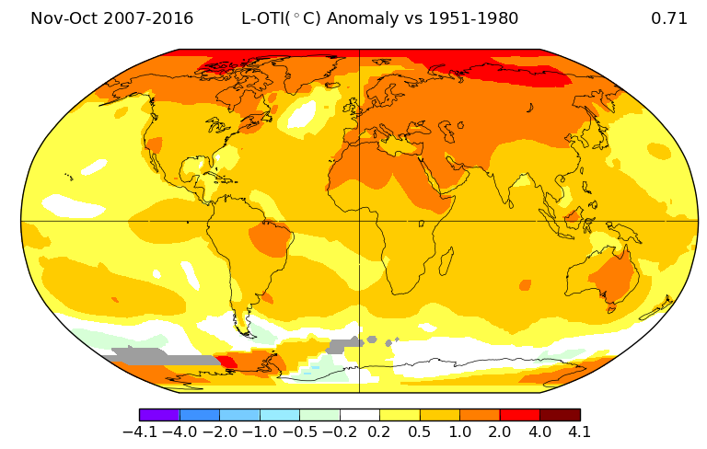
Observed changes
Les changements observés confirment les prévisions
NASA - GISS

Slide 24
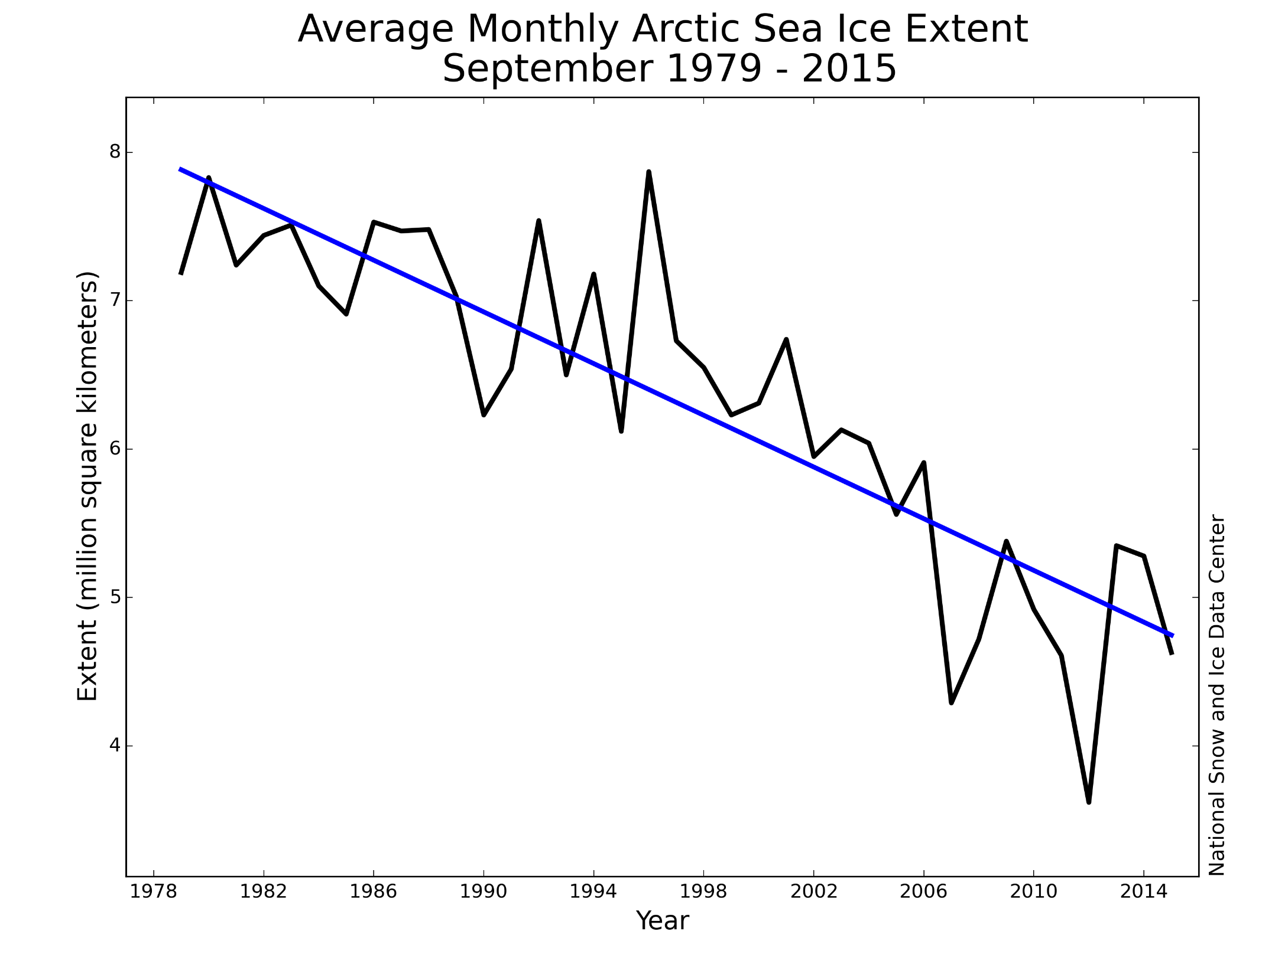

Slide 25
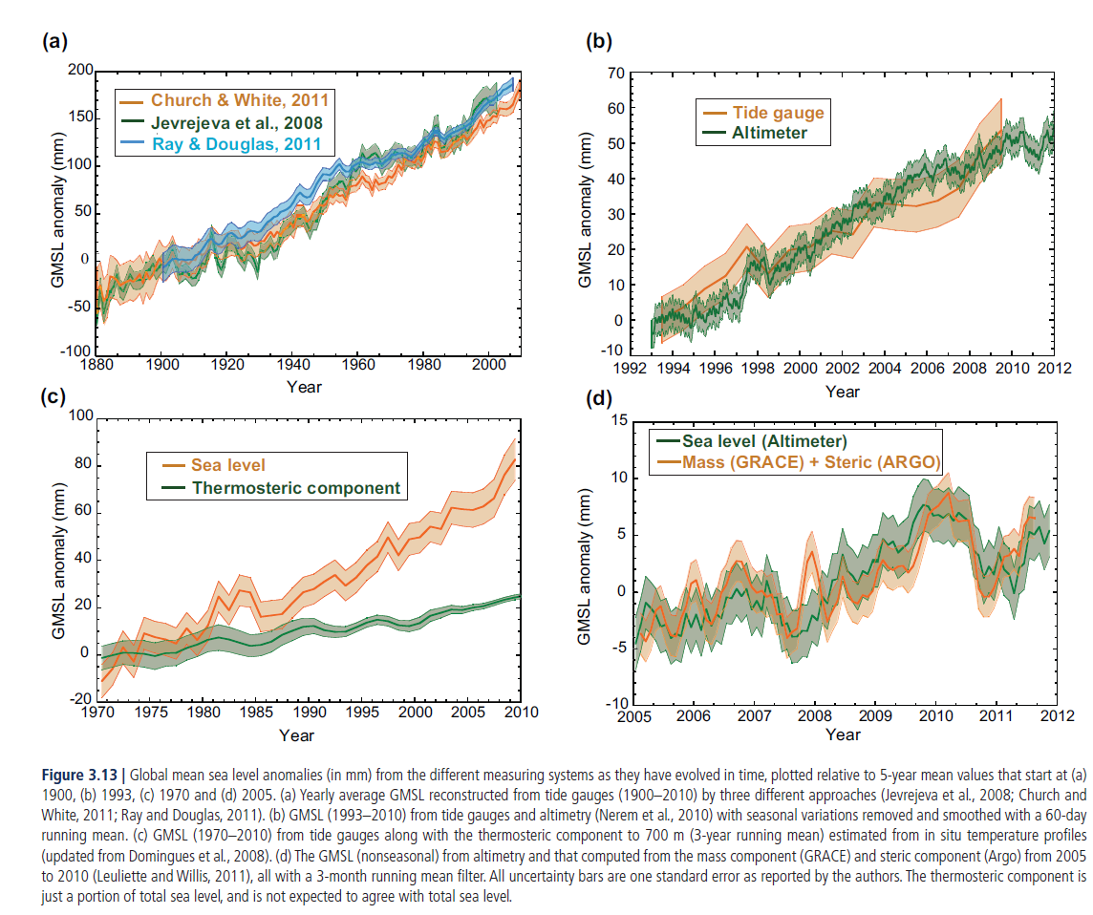
Global Mean Sea Level IPCC (2013)

Slide 26
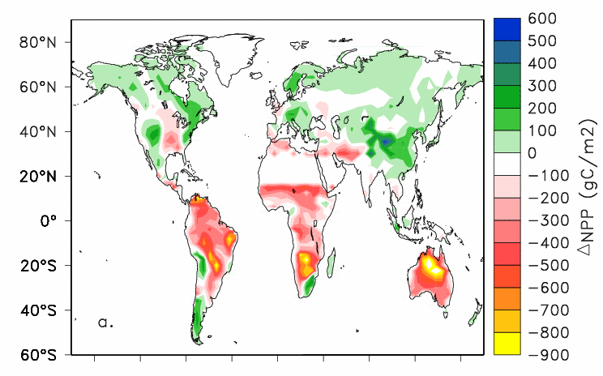
Net climate production: climate dependency
Increase in
soil aridity
Extension of the growing season
26
Berthelot et al., 2002
Notes:
26

Slide 27
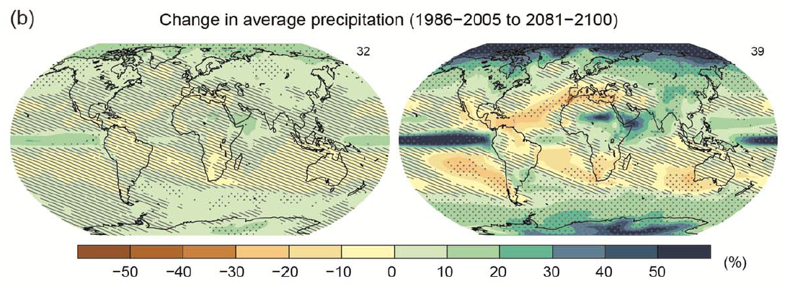
Changes in precipitations (IPCC, 2013, RCP)

Slide 28
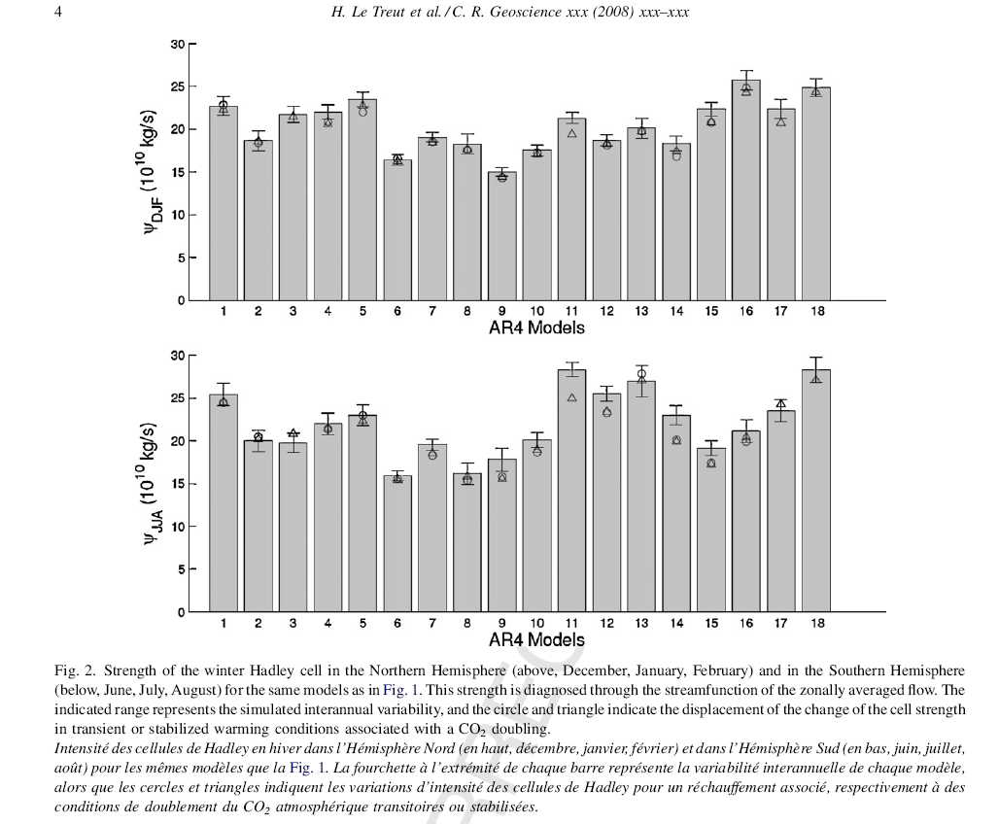
Changes in the Hadley Cell Circulations
Gastineau, Le Treut, Li, 2008

Slide 29
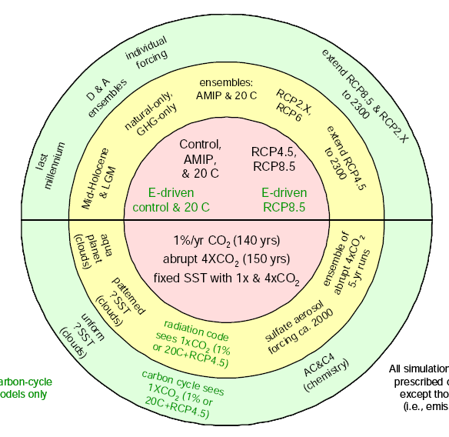
Simulations proposed by CMIP-5
Climate of the 20th
Century
Thématiques d'intérêt pour l'IPSL
Future Climate
(21st Century)
Climat-carbone
( C4MIP)
Nuages
(CFMIP)
Paléoclimat
(PMIP)
Aérosols
(AEROCOM)
Emissions
(GEIA)
Ozone
(CCMVal)
Paleoclimates
Radiative
Forcing
Climate sensitivity
and
Cloud Feedbacks
Atmospheric
Chemistry and
aerosols
Climat-carbon cycle coupling
Climat-carbone
( C4MIP, P. Friedlingstein)
Nuages
(CFMIP, S. Bony)
Paléoclimat
(PMIP P. Braconnot)
Aérosols
(AEROCOM, M. Schultz)
Emissions
(GEIA, C. Granier)
Ozone
(CCMVal, S. Bekki)

Slide 30
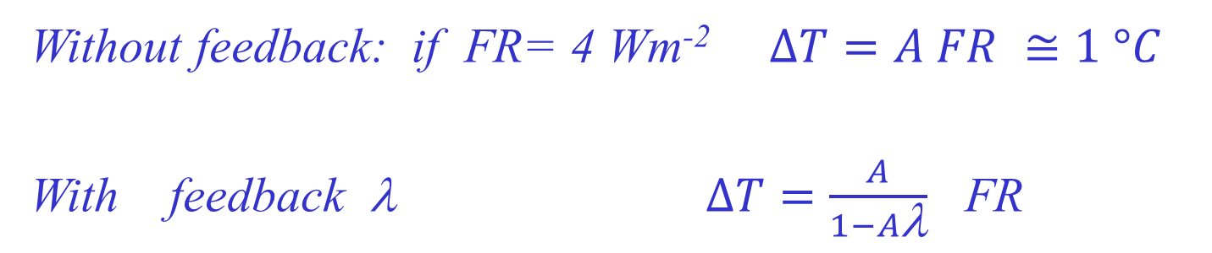
The principles of feedback processes
R = λ ΔΤ ( λ en Wm⁻² Κ⁻¹ )
FR (Wm⁻²)
ΔT = A FR ( °K)
>
>

Slide 31
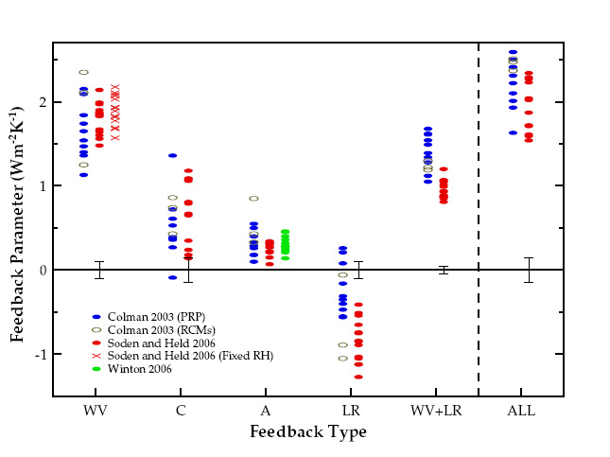
Inter-model spread in strength of climate feedbacks
Feedbacks from different models
(WV= water vapour, C = Clouds, A= Albedo, LR= Lapse-Rate)
Source : IPCC WGI AR4

Slide 32
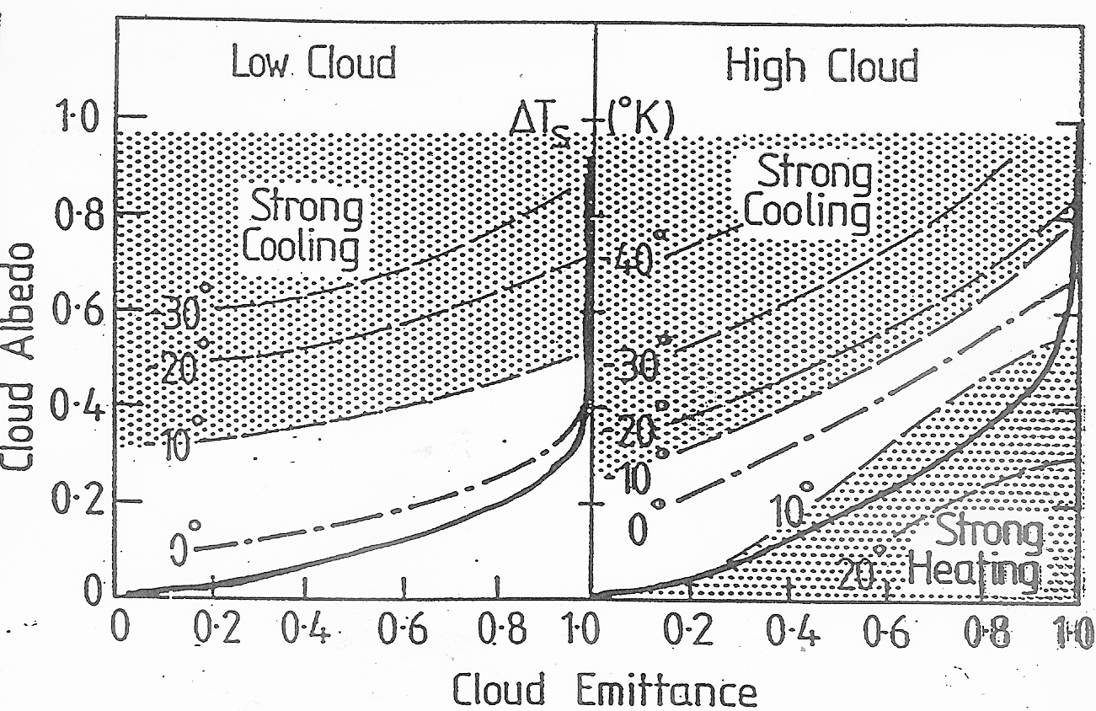
The complexity of Cloud Radiative Impact

Slide 33
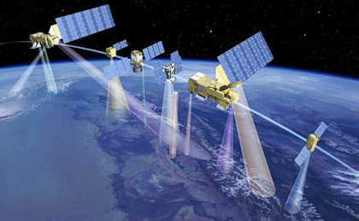
Illustration des 6 satellites composant l'A-train.
De gauche à droite :
Aura, Parasol, Calipso, Cloudsat, Aqua, OCO.
Crédits : CNES octobre 2004, illustration P. Carril

Slide 34
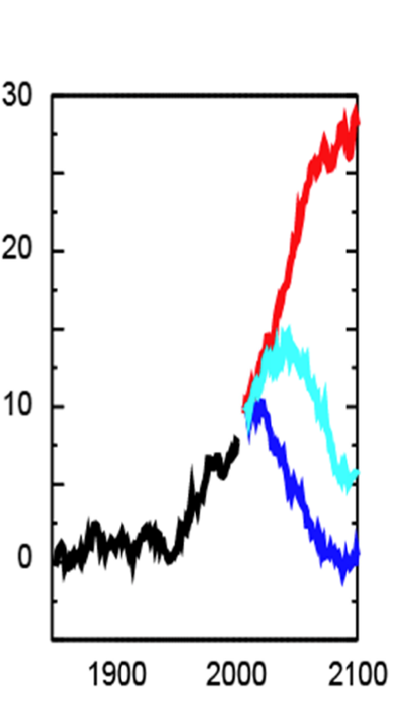
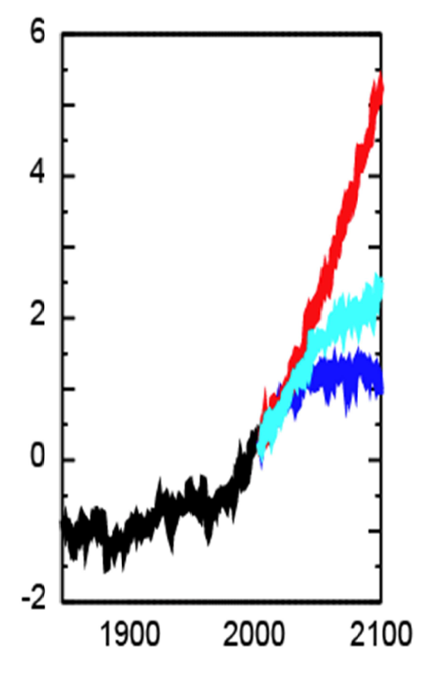
What are the authorized emissions to stabilize under a 2°C warming
IPSL / IPCC 2013
IPCC
Required CO₂ emissions
(in Gt per year)
Targeted Earth Surface
Temperature Changes
(in °C)
Scale of glacial
interglacial
climate changes

Slide 35
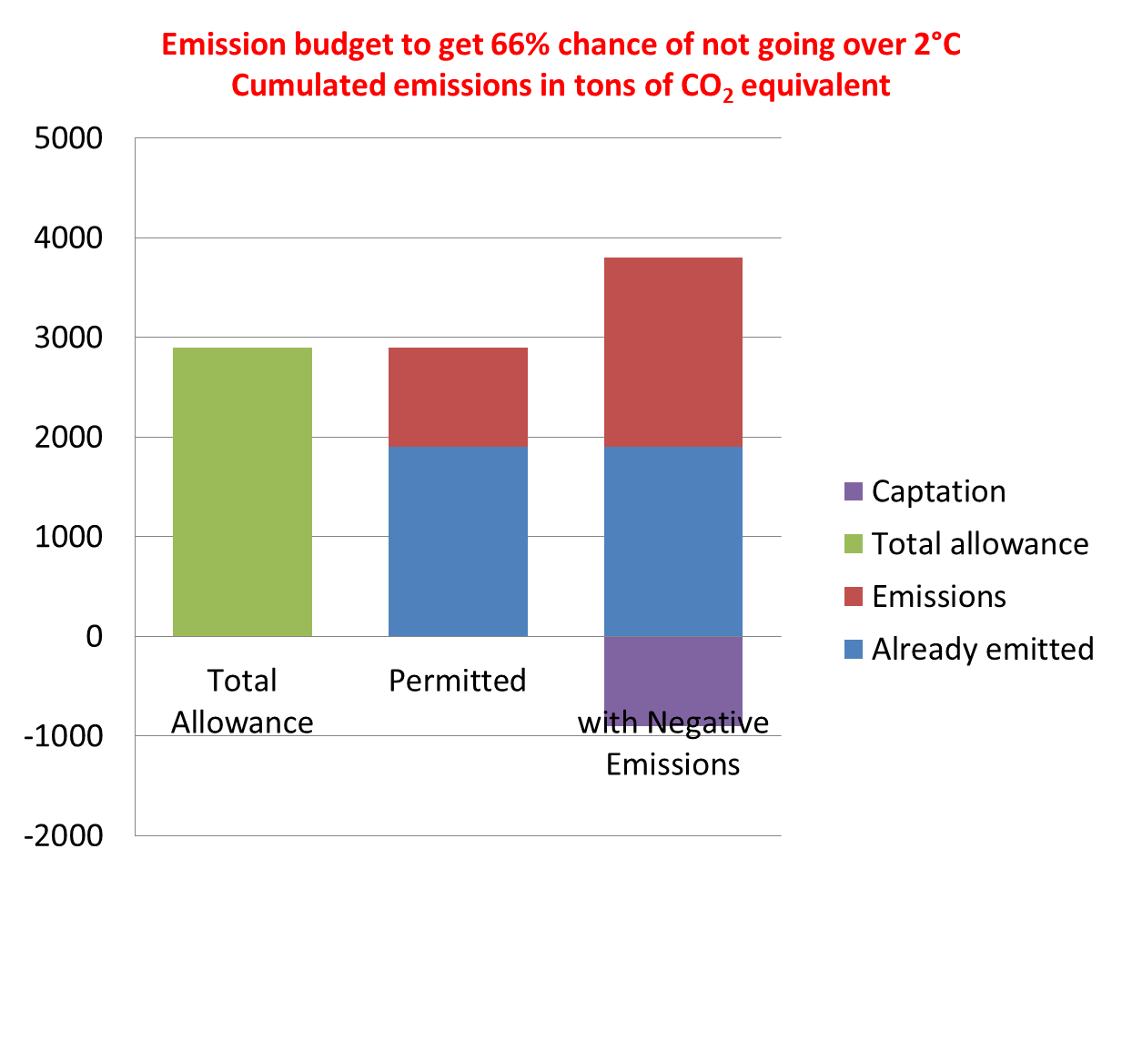
An increasing urgency
Source : GICN, 2015, frpm GIEC
Notes:
Chacune des techniques envisagées pour fournir ces émissions négatives peut être limitée en terme de potentiel, notamment par la difficulté de sa mise à l'échelle, ses coûts, sa consommation d’énergie, et son éventuelle compétition avec d’autres usages de ressources.
En outre, de grandes incertitudes pèsent sur ces techniques, notamment sur leurs bilans carbone réels, leurs impacts environnementaux, la disponibilité en biomasse pour la bioénergie due à l’évolution des rendements agricoles, l’impact du changement climatique sur leur efficacité et l’acceptation des populations.

Slide 36
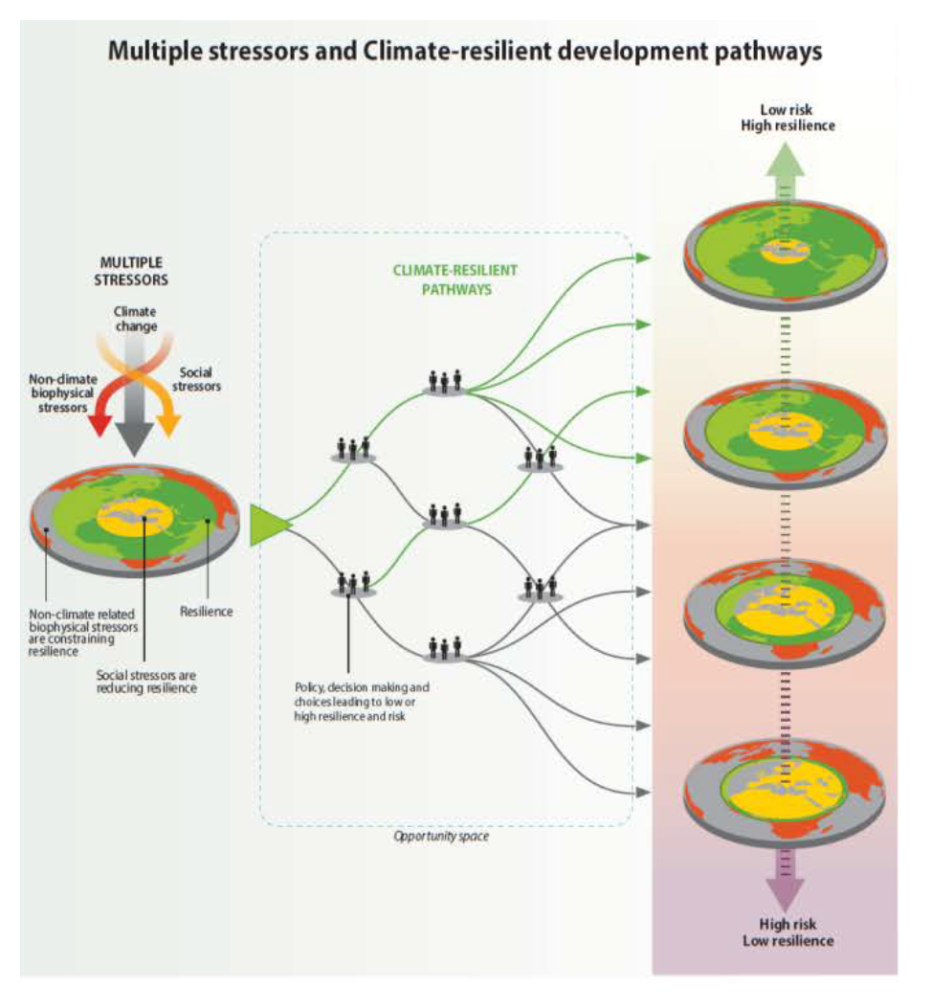
Comment concevoir l’action au cours des décennies
prochaines (GIEC – Groupe 2 – 2014)

Slide 37
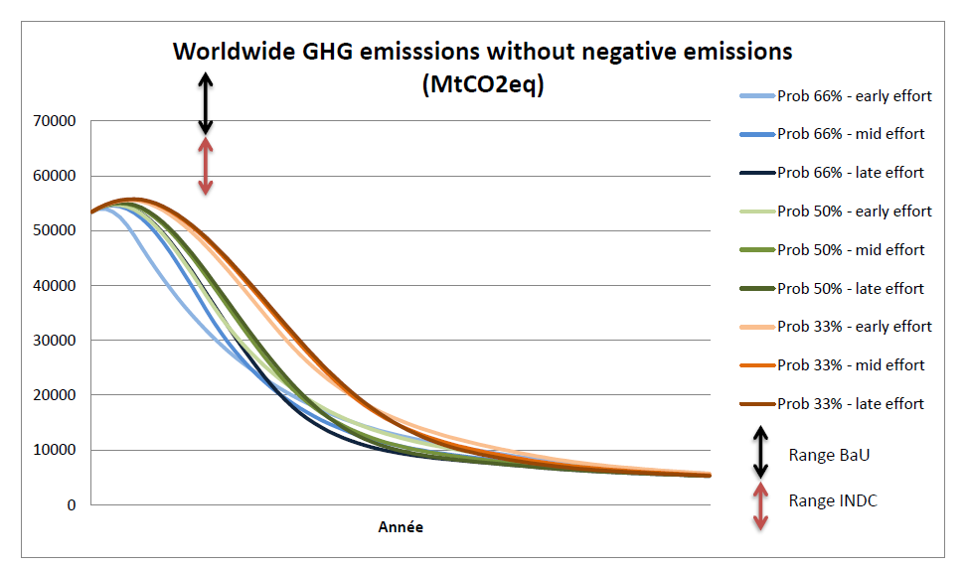
Impact of nation contributions
2015
2030
Impact of the emission reductions contributed by the different nations, as estimated
by the GICN during COP21

Slide 39
Future Climate Trajectories
IPSL / IPCC 2013
IPCC
Required CO₂ emissions
(in Gt per year)
Avoid any delay
Methane , Pollution
Structural actions
Transportation networks
Urbanism
Negative emissions
CCS, BECCS,

Slide 40
Adaptation is necessary and also requires
both fundamental and applied research
The limits of what is predictable or not are not well known
We need to explore climate changes as the changes of
a complex system, which requires mutidisciplinary approaches
A more comprehensisive approach of the link between
global and local perspectives is also a source of innovations in
many domains (« Big Data » in particular)

Slide 41
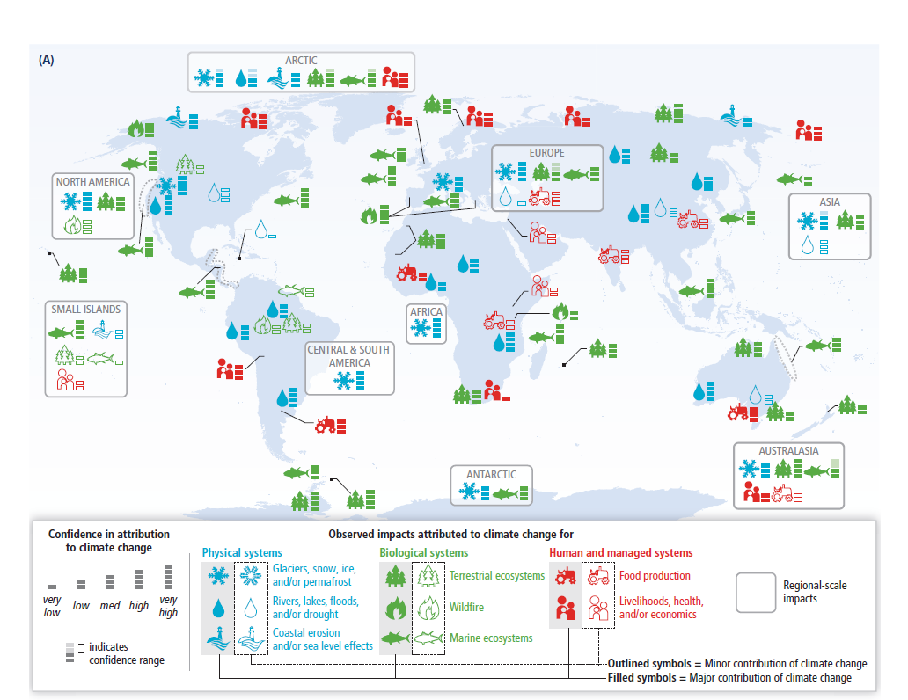
Adaptation: not always possible, but increasingly
necessary

Slide 42
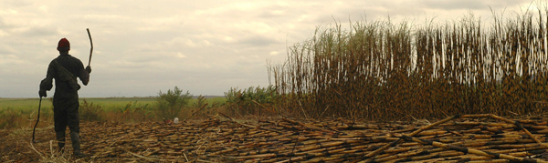
An unfair evolution reinforced by climate change: food requirements for the different
continents (FAO, cited by Benjamin Sultan IPSL/IRD)
Continent | Increase factor from 2000 to 2050
Africa | 5
Asia | 2.5
Europe | 1
Latin América | 2
North América | 1.5
Oceania | 1.5

Slide 43
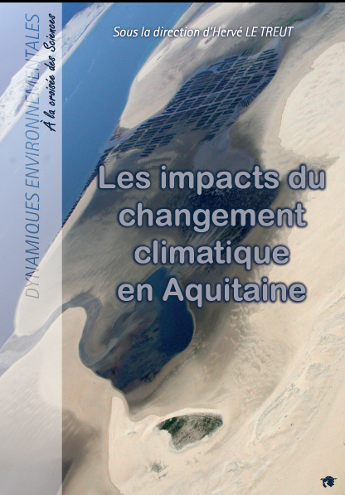
An example: a
« regional IPCC »
over Aquitaine

Slide 44
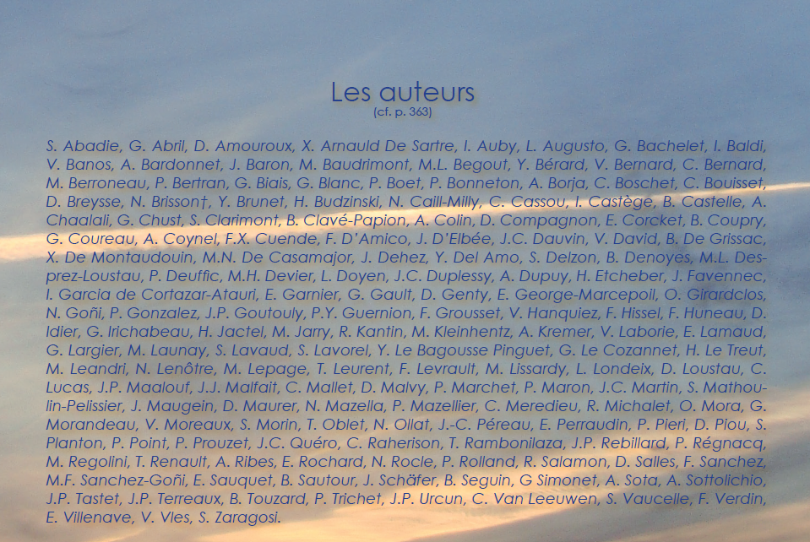
A collective work:
F. Grousset, A. Kremer, D. Salles, E. Villenave, E. Bourdenx

Slide 45
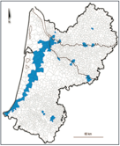


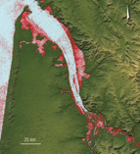

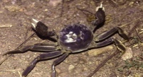
Looking at regional climate as a unique complex system
(from a study about the Bordeaux province in France)
Meteorological changes
Snow, Mountains
Air quality
Biodiversity
Health
Summertime rivers
, Hydrology
Fishery
and sea
resources
Littoral areas, erosion
Nuclear plant

